Slide 1
INDIAN STARTUP
FUNDING ANALYSIS
PROJECT
SNAPSHOT
Business & Sector Insights | 2015-2021
₹610.5K Cr
5,074
End-to-end analytics project: Python EDA + Power BI dashboard
Total Funding
Records
3,139
70.58%
Startups
Mega Deal Share
Python | pandas | Plotly | Power BI | DAX

Slide 2
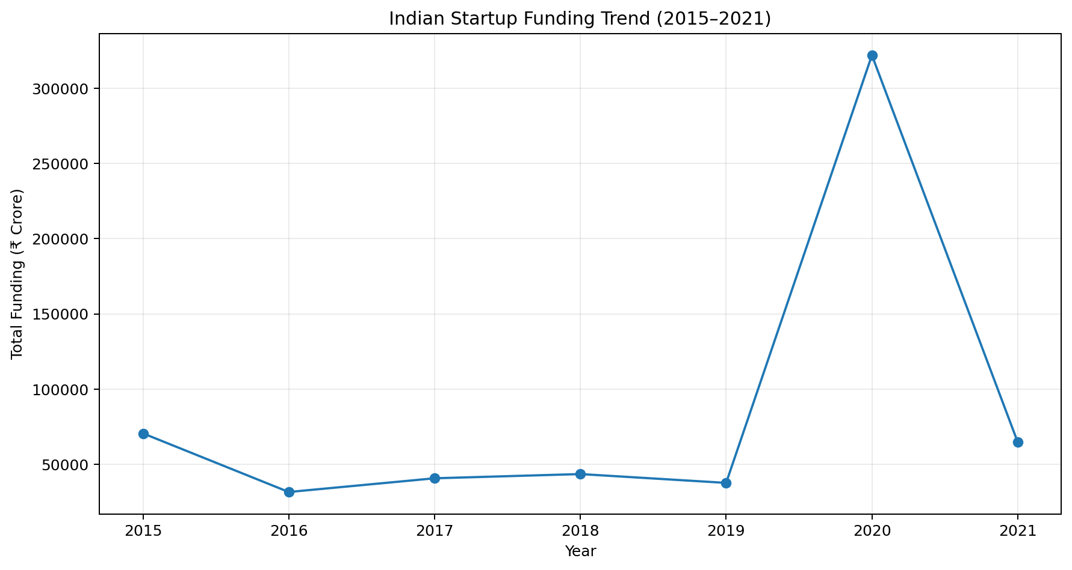
Executive Snapshot
The dataset shows a highly concentrated funding ecosystem where mega rounds materially shape headline totals.
₹610,548 Cr
68.49%
₹175.70 Cr
₹16.50 Cr
₹16,650 Cr
Total Funding
Disclosure Rate
Avg Disclosed Deal
Median Deal
Largest Round
• Mega deals of ₹500 Cr or more contributed 70.58% of total funding.
• The average disclosed deal was more than 10× the median, confirming a strongly right-skewed funding distribution.
• 31.51% of funding records had undisclosed amounts, so funding-value metrics and deal-count metrics must be interpreted separately.

Slide 3
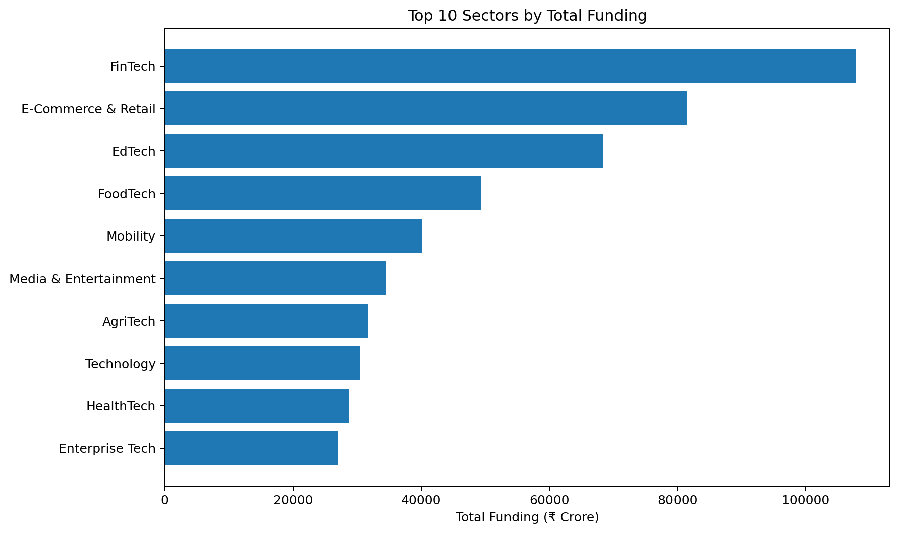
Sector Intelligence
Capital is concentrated in a small group of sectors, led by FinTech.
17.65%
42.19%
FinTech Share
Top 3 Sector Share
56.85%
₹107,771 Cr
Top 5 Sector Share
FinTech Funding
• FinTech ranked first by total capital, followed by E-Commerce & Retail and EdTech.
• Sector performance should be evaluated with deal count and median ticket size to distinguish broad activity from a few large rounds.

Slide 4
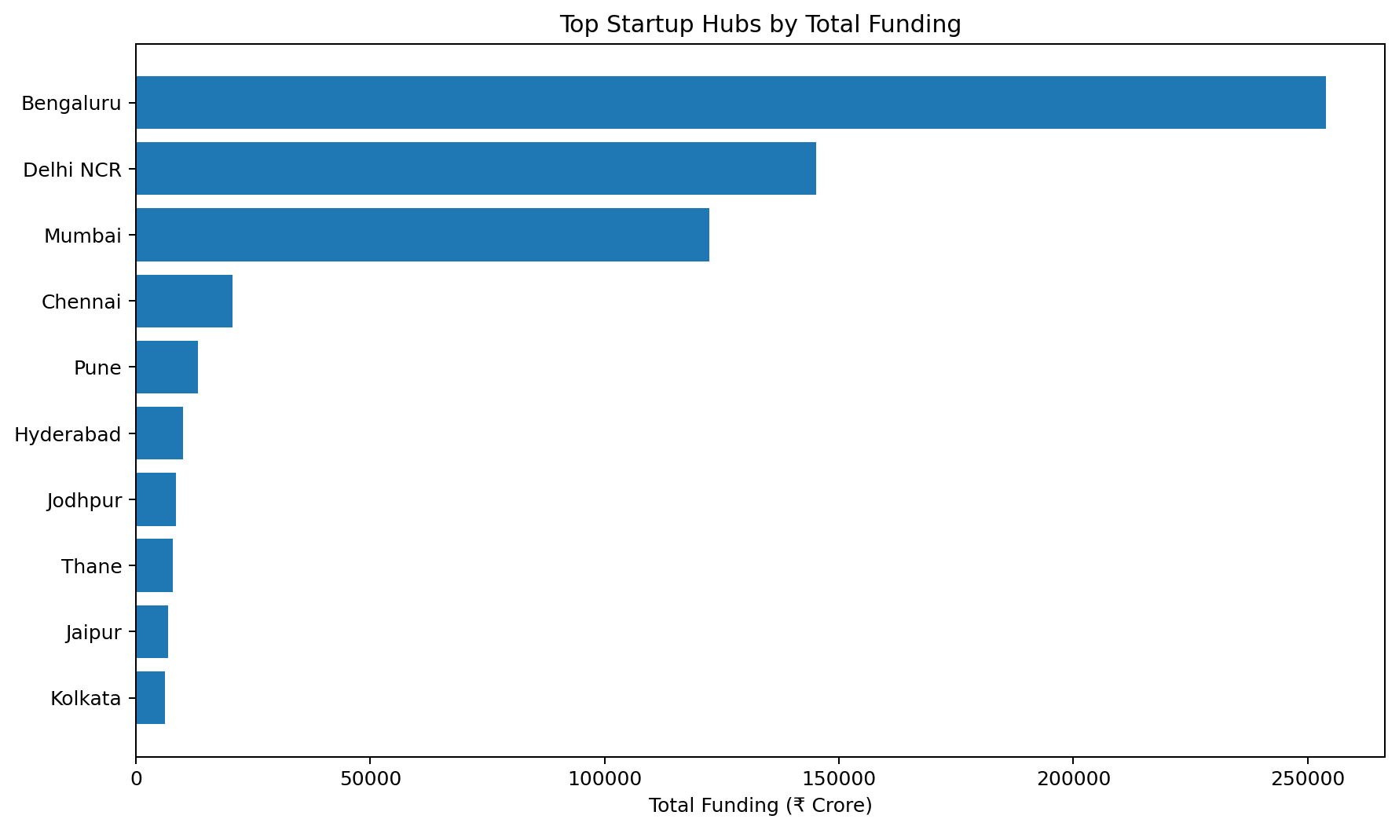
Geographic Ecosystem Concentration
Bengaluru, Delhi NCR, and Mumbai dominate the funding landscape.
41.58%
23.76%
Bengaluru Share
Delhi NCR Share
20.03%
85.37%
Mumbai Share
Top 3 Hub Share
• Bengaluru recorded ₹253,840.80 Cr across 1,643 funding records.
• The top three hubs captured more than 85% of total funding, showing much stronger geographic concentration than company-level concentration.

Slide 5
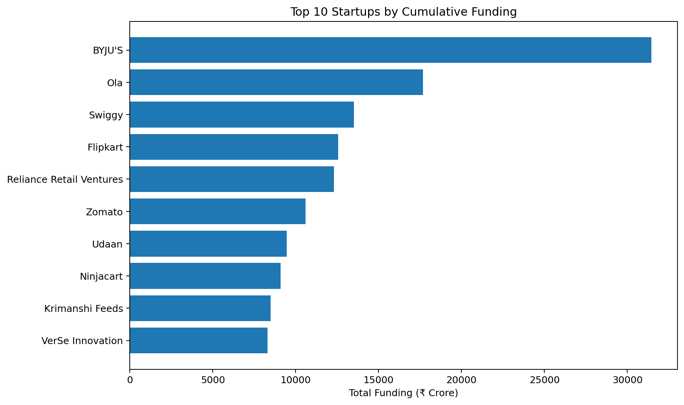
Startup Funding Concentration
A small group of companies captured a meaningful, but not dominant, share of total capital.
14.33%
21.86%
Top 5 Share
Top 10 Share
33.39%
₹31,445 Cr
Top 20 Share
BYJU'S Funding
• The highest-funded startups include BYJU'S, Ola, Swiggy, Flipkart, Reliance Retail Ventures, and Zomato.
• Company-level concentration is notable, but less extreme than the concentration across startup hubs.

Slide 6
Power BI Dashboard Architecture
Four pages convert the analysis into an interactive business intelligence product.
1
Executive Overview
Funding KPIs, annual trend, leading sectors, startup hubs, and funding stages.
2
Sector Intelligence
Sector funding, deal activity, average ticket size, trends, and funding-vs-deal analysis.
3
Startup & Funding Analysis
Top startups, funding frequency, funding stages, stage deal counts, and funding-size distribution.
4
Geographic Ecosystem
Startup hub rankings, average deal size, hub trends, and state-level funding.

Slide 7
Business Recommendations
Use the dashboard to separate broad market health from headline capital spikes.
01
Track capital quality
Pair total funding with deal count, median deal size, unique startups, and mega-deal share.
02
Separate mega deals
Report funding with and without ₹500 Cr+ rounds to expose the underlying market.
03
Monitor sector momentum
Watch sectors where deal activity accelerates before total funding peaks.
04
Combine sector + geography
Use hub specialization to guide investment sourcing and ecosystem research.
05
Screen secondary hubs
Track growth in Chennai, Pune, Hyderabad, and other ecosystems beyond the top three.

Slide 8
KEY TAKEAWAY
Total funding alone does not describe the health of a startup ecosystem.
Mega-deal dependence, median ticket size, sector concentration, geographic concentration, and deal activity provide the context needed to interpret headline capital.
Project deliverables
Python EDA • Power BI Dashboard • Executive Report • GitHub README • Portfolio Presentation

